Slide 2

Comparative Analysis of ML Algorithms For Twitter Hate Speech Detection
Project Members:
Aryan Rastogi (1900910100045)
Daarshik Dwivedi (1900910100058)
Arjit Kumar (1900910100043)
Abhishek Pratap Singh (1900910100008)
Supervisor Name:
Ms. Suruchi Saberwal

Slide 3
CONTENTS
Introduction
Objectives
Project Design
Datasets Extracted
Papers Studied for Literature Survey
Literature Survey
Conclusions from Literature Survey
Distributions of Features
Frequency Distribution of Non-Hate Tweets
Frequency Distribution of Hate Tweets
Class Distribution of Processed Dataset
Dataset Split
Base Model Performance Comparison
Hyper-Parameter Tuned model performance comparison
Conclusion
Future Scope
References

Slide 4
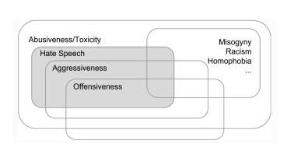
INTRODUCTION
Hate speech is “the use of aggressive or offensive language, targeting a specific group of people sharing a common trait.”
Effect of Hate speech on Social Media
Opinion inclination
Cyber bullying
False information propagation
Low self-esteem, anxiety and stress on the targets

Slide 5
OBJECTIVES
This project is a comparative study of classification system for Hate Speech Recognition models on Twitter Platform.
The steps of this project will include:
Data extraction.
Data analysis of collected data.
Feature Identification using literature survey to improve insights.
Building base ML models
Fine Tuning selected machine learning models
Comparative analysis of model performance.

Slide 6
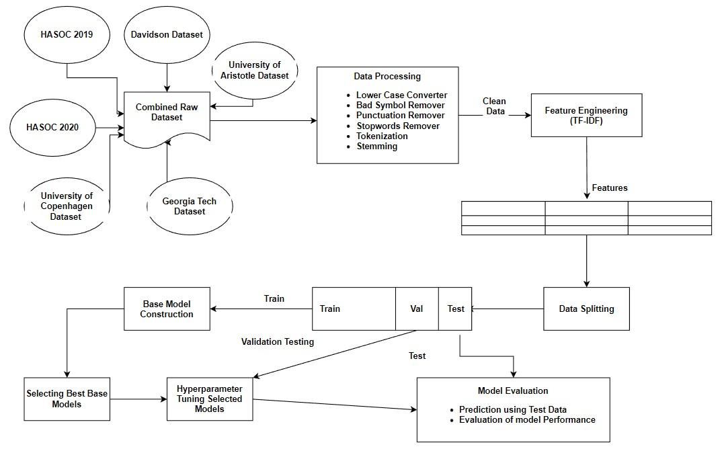
PROJECT DESIGN

Slide 7
DATASETS EXTRACTED
Name of Dataset | Detail of Instances Used
Davisdon Dataset[24] | 23353 Non hate tweets and 1430 Hate Tweets used
University of Aristotle Hate Speech Dataset[20] | 1614 Hate Speech Tweets used
University of Copenhagen Hate Speech Dataset[1] | 2684 Hate Speech Tweets used
HASOC 2019[21] | 58 Hate Speech Tweets used
HASOC 2020[22] | 131 Hate Speech Tweets used
Georgia Tech Hate Speech Dataset[23] | 1500 Hate Speech Tweets used

Slide 8
PAPERS STUDIED FOR LITERATURE REVIEW
Year of Publication | Title
2016 | Are You a Racist or Am I Seeing Things? Annotator Influence on Hate Speech Detection on Twitter [2]
2016 | Hateful Symbols or Hateful People? Predictive Features for Hate Speech Detection on Twitter [1]
2017 | Automated Hate Speech Detection and the Problem of Offensive Language [3]
2017 | Deep Learning for Hate Speech Detection in Tweets [4]
2018 | Detecting Online Hate Speech Using Context-Aware Models [5]
2018 | Hateminers: Detecting Hate Speech against Women [11]
2018 | Comparative Studies of Detecting Abusive Language on Twitter [12]
2019 | A BERT-Based Transfer Learning Approach for Hate Speech Detection in Online Social Media [13]
2020 | HateXplain: A Benchmark Dataset for Explainable Hate Speech Detection [14]
2020 | Multilingual Twitter Corpus and Baselines for Evaluating Demographic Bias in Hate Speech Recognition[16]
2021 | Hate speech detection using static BERT embeddings [17]
2021 | HateBERT: Retraining BERT for Abusive Language Detection in English [18]
2022 | Semi-supervised Stance Detection of Tweets Via Distant Network Supervision [19]

Slide 9
Literature Survey of Hate Speech Detection Papers
Machine Learning Techniques
Deep Learning Techniques
Datasets
Logistic Regression, [1-3][5][14][16]
CNN, [4][12-14][16][17][19]
Crowdflower Dataset, [3]
Random Forests, [2][3][5][12]
LSTM, [4][5][17][19]
HateMiners Dataset, [11]
Support Vector Machines, [2][3][12]
RNN, [12][16]
Naive Bayes, [2]
BERT, [13][14][16-18]
Gradient Boosting Decision Trees, [12]

Slide 10
CONCLUSIONS FROM LITERATURE SURVEY
Demographic info (gender, n-grams) does not improve hate speech detection significantly.
Experienced annotators yield better classification models.
Logistic regression (L2 regularization, TF-IDF) identifies hate speech but with high misclassification rates.
CNN and LSTM-based models with TF-IDF and random embedding show promise for classifying sexist, racist, or neutral tweets.
Ensemble models improve hate speech classification (higher AUC and F1-scores).
RNNs with LSTM cells and Bidirectional GRU networks are highly accurate in detecting abusive language.
BERT-based models, especially with CNN fine-tuning, outperform baselines in hate speech detection.
Demographic factors enhance text classifier performance and address bias concerns in multilingual contexts.
Transfer learning with pre-trained BERT models improves hate speech comprehension across datasets.
HateBERT model excels in detecting hate speech and abusive language.

Slide 11
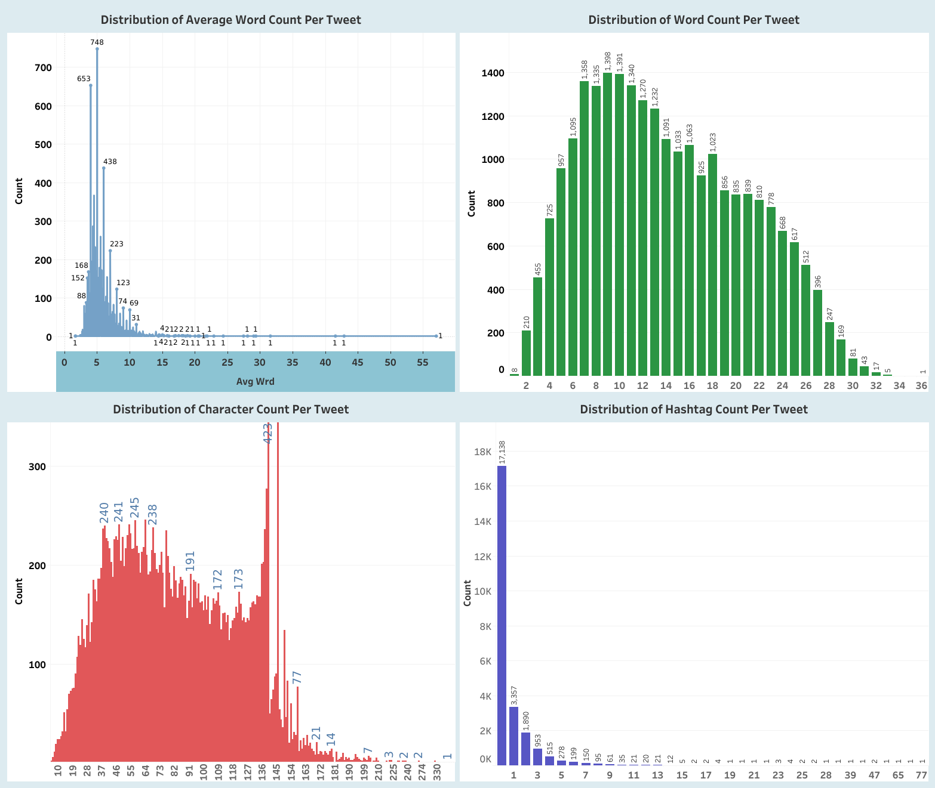
DISTRIBUTION OF FEATURES
Fig 1: Dist. of Character Count per Tweet Fig 2: Dist. of Hashtag Count per Tweet

Slide 12
DISTRIBUTION OF FEATURES
Fig 1: Dist. of Average Word Count per Tweet Fig 2: Dist. of Word Count per Tweet

Slide 13
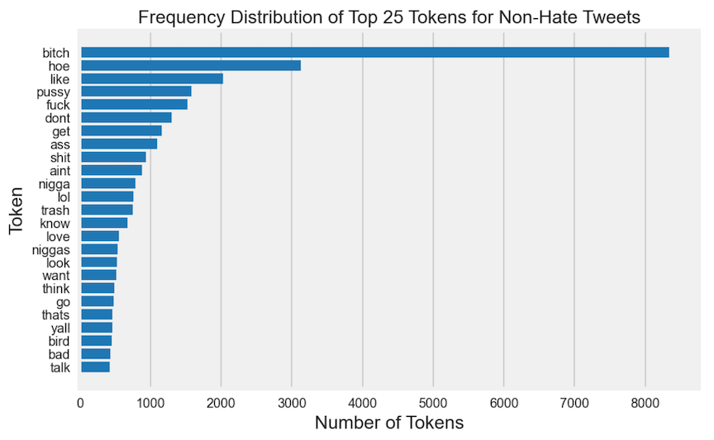
FREQUENCY DISTRIBUTION OF NON-HATE TWEETS

Slide 14
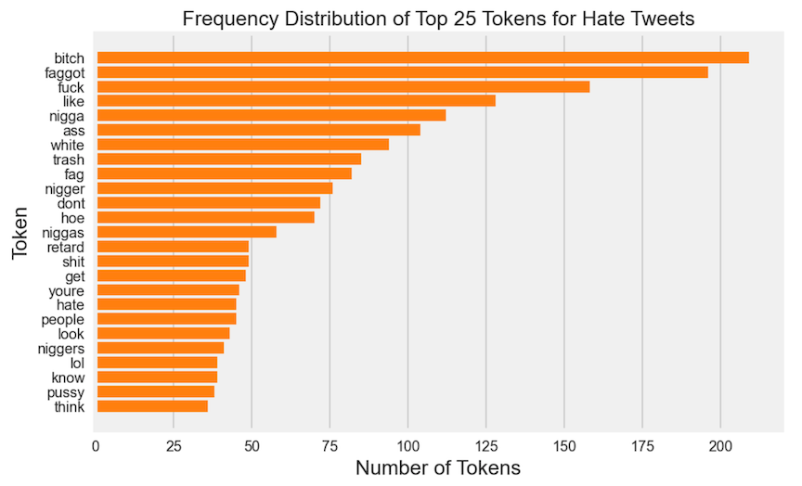
FREQUENCY DISTRIBUTION OF HATE TWEETS

Slide 15
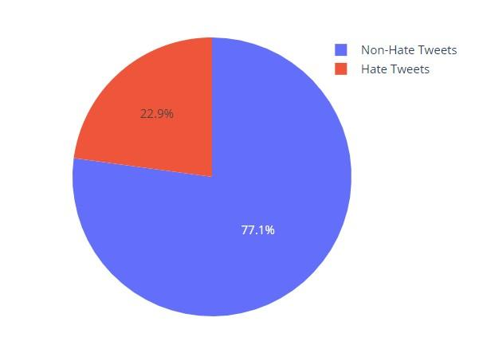
CLASS DISTRIBUTION OF PROCESSED DATASET

Slide 16
DATASET SPLIT
 | Class Label | Total Instances | Training Instances | Validation Instances | Testing Instances
0 | Non-Hate Tweets | 23353 | 17514 | 3503 | 2336
1 | Hate Tweets | 7417 | 5562 | 1113 | 742
To divide the preprocessed data into training and validation sets, we utilised a 75:25 ratio, or 75% for training and 25% for validation.
To create the test data, the validation dataset was once more divided in half using a 60:40 ratio.

Slide 17
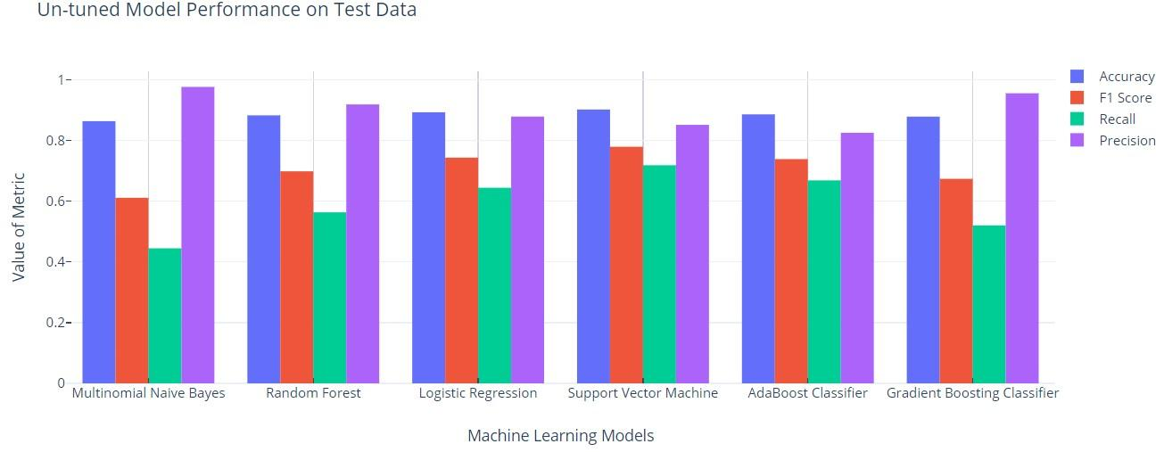
BASE MODEL PERFORMANCE
 | Accuracy | F1 Score | Recall | Precision
Multinominal Naive Bayes | 0.86 3548 | 0.611111 | 0.44744 | 0.976331
Random Forest[25] | 0.882716 | 0.698413 | 0.563342 | 0.918681
Logistic Regression[28] | 0.892788 | 0.743390 | 0.644205 | 0.878676
Support Vector Machine[26] | 0.901884 | 0.779240 | 0.718329 | 0.851438
Adaboost Classifier[27] | 0.885965 | 0.738645 | 0.668464 | 0.825291
Gradient Boosting Classifier | 0.878493 | 0.673647 | 0.520216 | 0.955446

Slide 18
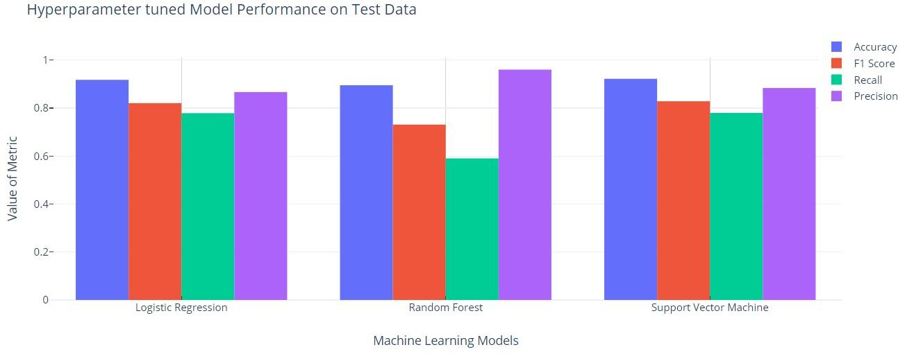
HYPER-PARAMETER TUNED MODEL PERFORMANCE
 | Accuracy | F1 Score | Recall | Precision
Logistic Regression w/GridsearchCV[28] | 0.917894 | 0.820634 | 0.778976 | 0.867000
Random Forest w/GridsearchCV[25] | 0.895364 | 0.731219 | 0.590296 | 0.960526
Support Vector Machine w/GridsearchCV[26] | 0.922227 | 0.828640 | 0.77987 | 0.883910

Slide 19
CONCLUSION
On applying six base binary classification models on the imbalance hate speech dataset, it was found that the SVM model was the most accurate, with an accuracy of 90.19%.
However, several studies notes that accuracy is not the ideal statistic for assessing a model's performance with an unbalanced dataset.
When compared with the base models, the F1 Score, Recall, and Precision results showed that the SVM model performed better than the other models, with F1 scores of 0.779 and 0.718 for recall and 0.851 for precision.
After hyperparameter tuning with 5-fold cross validation, the SVM model's performance significantly improved, with an F1 Score of 0.829, Recall of 0.780, and Precision of 0.884.
The study concludes that the SVM model is a viable option for detecting hateful speech on social media, particularly when working with unbalanced datasets.
The study suggests that when evaluating the performance of a model on an unbalanced dataset, it is essential to prioritize measures such as F1 Score, Recall, and Precision over accuracy.

Slide 20
FUTURE SCOPE
Model Ensembling: Investigate combining multiple models' predictions to improve overall performance.
Transfer Learning: Explore fine-tuning pretrained models like BERT or GPT for hate speech detection.
Online Learning: Develop models that adapt to evolving hate speech patterns in real-time.
User-level Analysis: Focus on individual behavior to identify repeat offenders and patterns.
Address Bias and Fairness: Ensure fairness and mitigate biases in hate speech detection models.
Multilingual and Cross-cultural Analysis: Extend hate speech detection to different languages and cultural contexts.

Slide 21
REFERENCES
Hovy, D. & Waseem, Z. (2016). Hateful Symbols or Hateful People? Predictive Features for Hate Speech Detection on Twitter. North American Chapter of the Association for Computational Linguistics.
Zeerak Waseem. 2016. Are You a Racist or Am I Seeing Things? Annotator Influence on Hate Speech Detection on Twitter. In Proceedings of the First Workshop on NLP and Computational Social Science, pages 138–142, Austin, Texas. Association for Computational Linguistics.
Warmsley, D, Davidson, Weber, I &, Macy, M.W.(2017) Automated Hate Speech Detection and the Problem of Offensive Language. International Conference on Web and Social Media.
Gupta, M., Gupta, S., Badjatiya, P& Varma, V(2017). Deep Learning for Hate Speech Detection in Tweets. Proceedings of the 26th International Conference on World Wide Web Companion.
Huang, R& Gao, L.(2017). Detecting Online Hate Speech Using Context-Aware Models. Recent Advances in Natural Language Processing.
Jaiswal A, Kumar A. Systematic literature review of sentiment analysis on Twitter using soft computing techniques. Concurrency and Computation: Practice and Experience. 2020 Jan 10;32(1):e5107.
Patti V, Bosco C, Sanguinetti M, Basile V, Poletto F. Resources and benchmark corpora for hate speech detection: a systematic review. Language Resources and Evaluation. 2020 Sep 30:1-47.
Hafiz M, Anam MC. Surat Edaran Kapolri Tentang Penanganan Ujaran Kebencian (Hate Speech) dalam Kerangka Hak Asasi Manusia. Jurnal Keamanan Nasional. 2015 Dec 28;1(3):341-64.
Chang Y, Mehdad Y, Thomas A, Tetreault J, Nobata C. Abusive language detection in online user content. InProceedings of the 25th international conference on world wide web 2016 Apr 11 (pp. 145-153).
Hartanto AD, Adi S, Hayaty M. Lexicon-Based Indonesian Local Language Abusive Words Dictionary to Detect Hate Speech in Social Media. Journal of Information Systems Engineering and Business Intelligence. 2020 Apr 27;6(1):9-17.
Mukherjee, A., Goyal, P, Mathew, B&Saha, P(2018). Hateminers: Detecting Hate speech against Women. ArXiv, abs/1812.06700.

Slide 22
THANK YOU

